Slide 1
Agentic AI Health Symptom Checker
CAPSTONE PROJECT
Presented By:
ANSHU SAI-S.J.C INSTITUTE OF TECHNOLOGY-CSE

Slide 2
OUTLINE
Problem Statement
Proposed System/Solution
System Development Approach
Algorithm & Deployment
Result (Output Image)
Conclusion
Future Scope
References

Slide 3
Problem Statement
An Agentic AI Health Symptom Checker helps users understand their health conditions
by analyzing symptoms and providing probable causes, preventive advice, and care recommendations.
It retrieves verified medical data, symptom databases, and guidelines from trusted sources like WHO,
government health portals, and medical journals.

Slide 4
Proposed Solution
An Agentic AI Health Symptom Checker is developed to guide users in understanding their health symptoms by:
Analyzing natural language symptom Providing: • Probable health conditions • Urgency level (low, medium, high) • Preventive advice and home remedies • Guidance on when to consult a doctor
Powered by IBM Watsonx.ai, the agent is trained to: • Use verified medical databases (WHO, CDC, government health portals) • Support multilingual interaction (e.g., English, Hindi, Kannada) • Avoid self-diagnosis by delivering educational and referral-based suggestions
This AI-driven assistant aims to promote early detection, reduce misinformation, and empower users to take informed, safe health actions.

Slide 5
System Approach
IBM Watsonx.ai – Foundation model deployment
IBM Cloud Object Storage – For asset management
Streamlit (Optional) – For user-friendly web UI
Language Detection Library
Translation APIs – For multilingual support (e.g., Google Translate API)
Verified Medical Datasets – WHO, CDC, Government health portals
Libraries Used:ibm-watsonx-ai – Accessing IBM foundation modelsstreamlit – Lightweight
UI for testing (optional)
langdetect – Detects language of user input
Requests-json API calls and data handling
dotenv –For secure environment variable storage (e.g., API keys)

Slide 6
Algorithm & Deployment
Algorithm Selection: IBM Watsonx Foundation Model: Granite-13B-Chat-v2
• Large Language Model (LLM) used for symptom understanding
• Works through prompt engineering (no retraining needed)
• Supports multilingual, safe, and informative responses
Input & Response Process
• Input: User’s symptom in natural language (e.g., “I have a sore throat and fever”)
• Language detection performed if not in English
• AI processes the prompt and responds with:– Probable health condition(s)– Urgency level (low/medium/high)– Preventive care & home tips– Referral advice (if needed)– Safety disclaimer

Slide 7
Algorithm & Deployment
Deployment Workflow
User enters symptom (via UI or notebook)
System detects input language
Constructs prompt with safety instructions
Sends prompt to Watsonx.ai API
Receives structured response
6. Displays result in user’s language Hosting & Access
Can be extended to mobile or chatbot platforms

Slide 8
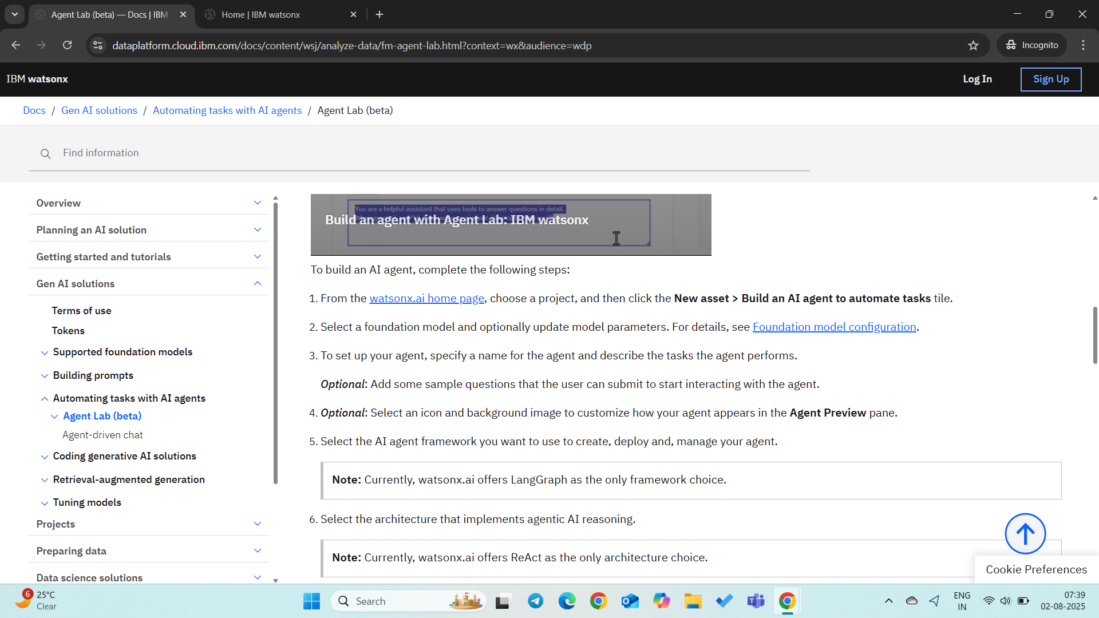
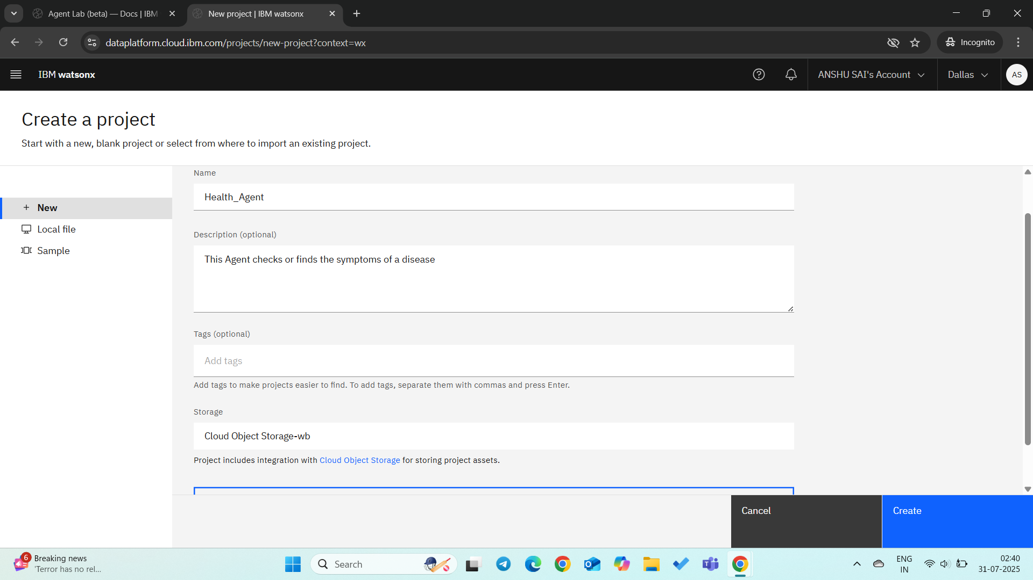
Result
GO to watsonx ai home page create a new project

Slide 9
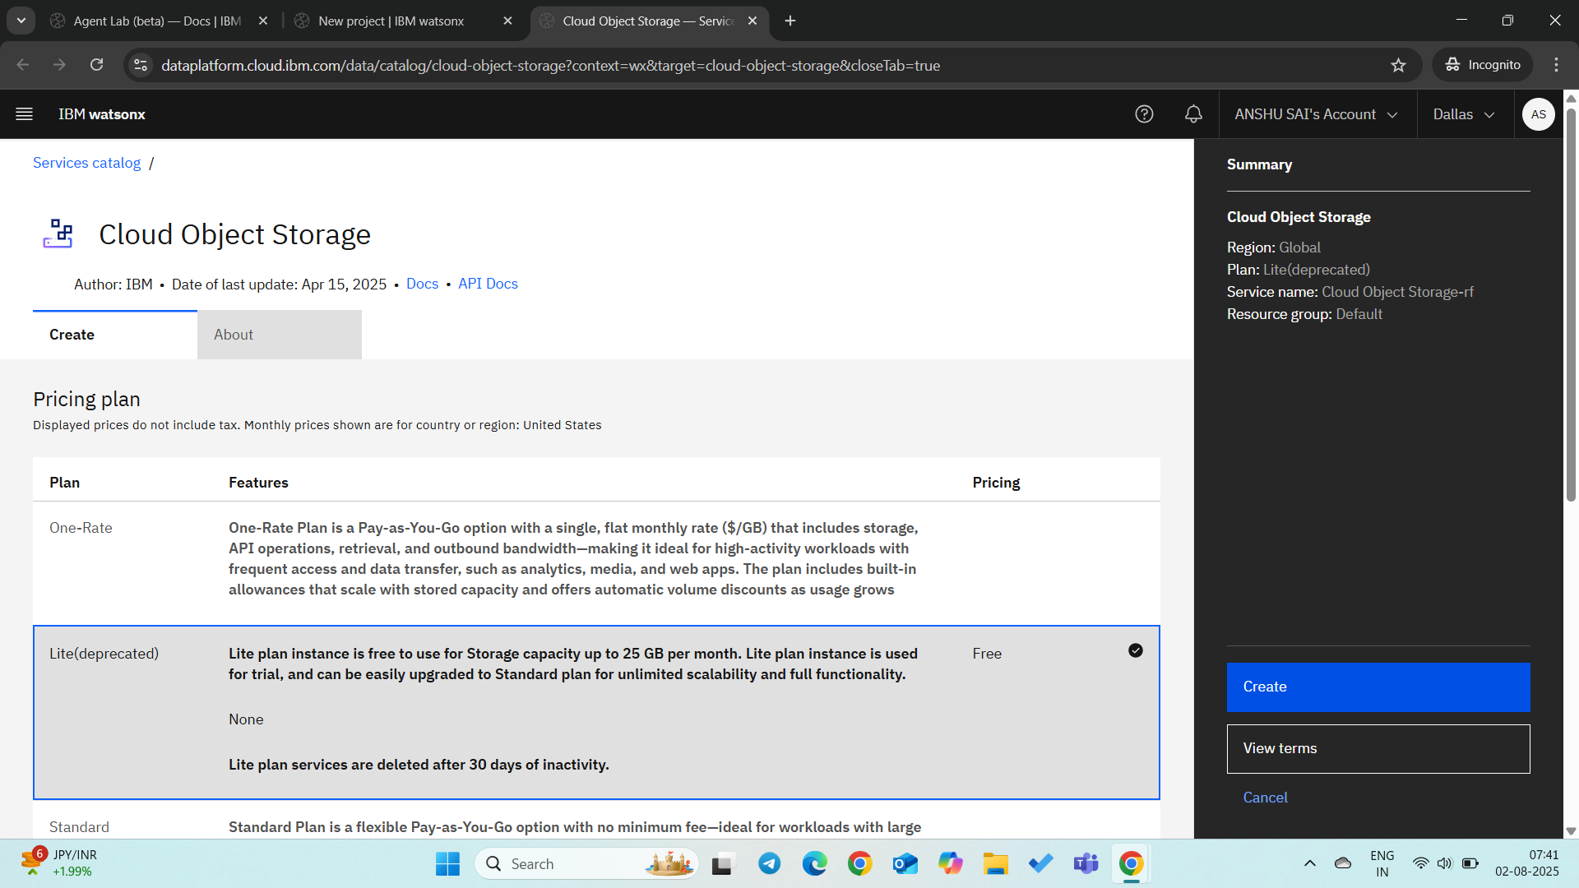
Result
Click on Add Cloud storage and select free plan and create it

Slide 10
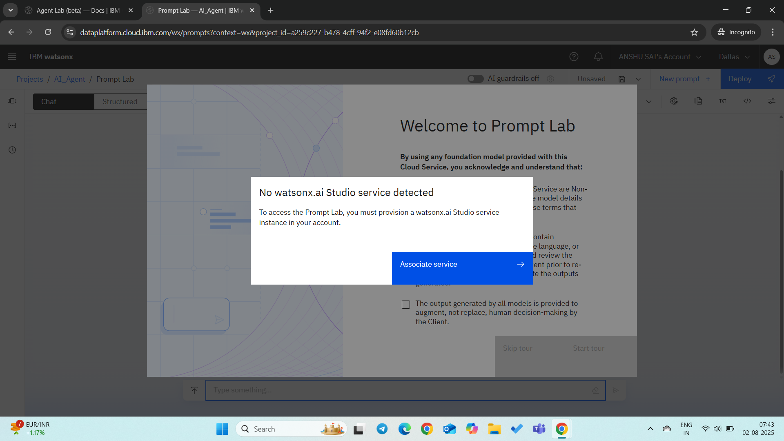
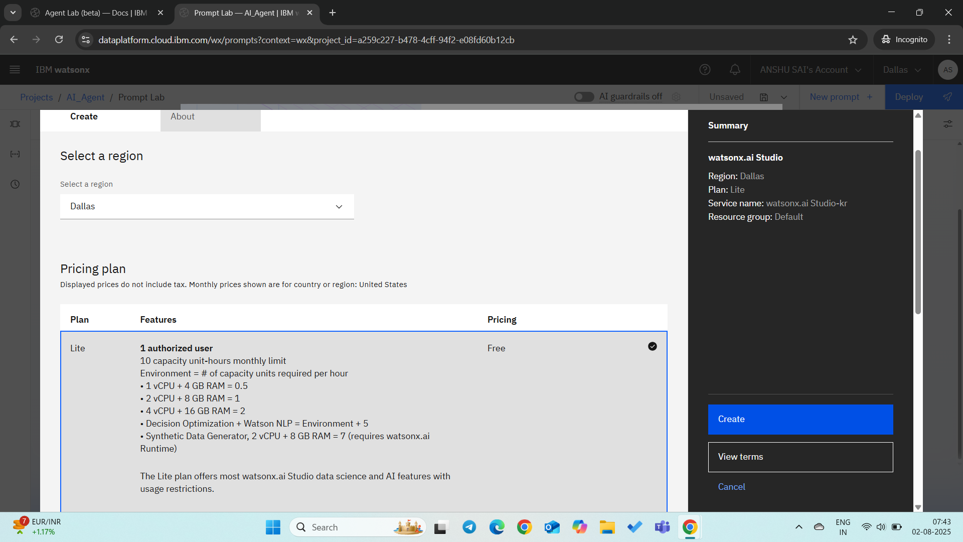
Result
Now you can click on Build an AI agent to automate tasks click on associate service click on create

Slide 11
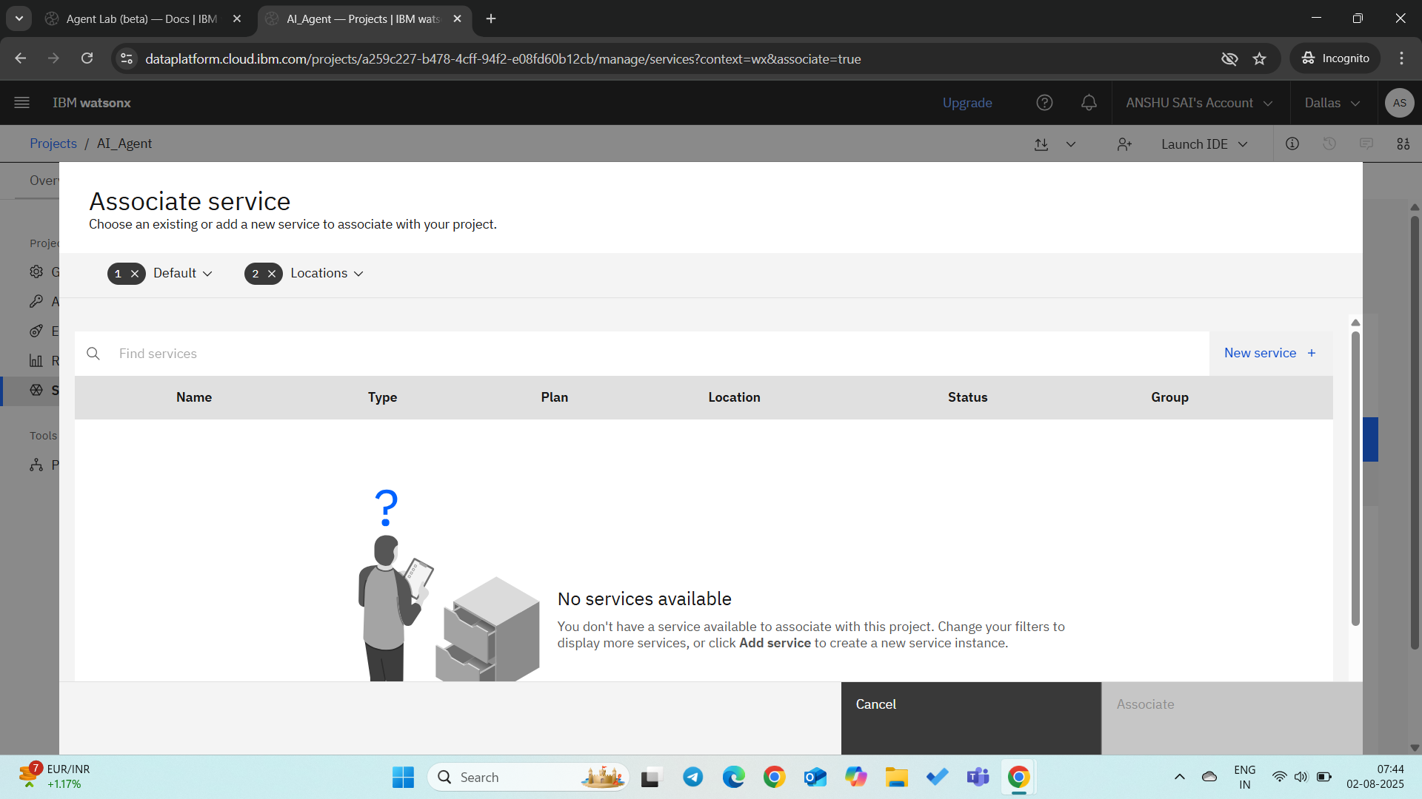
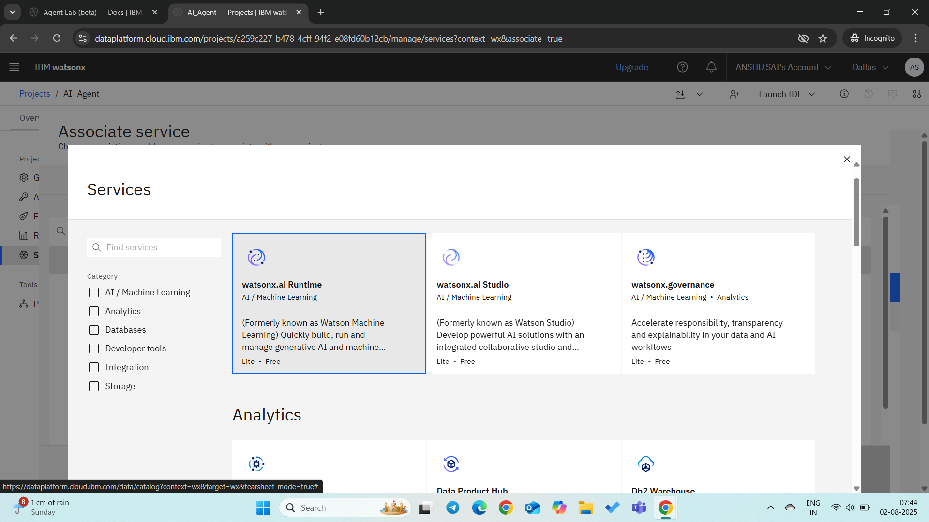
result
In associate service click on new service select watsonx runtime and associate it.

Slide 12
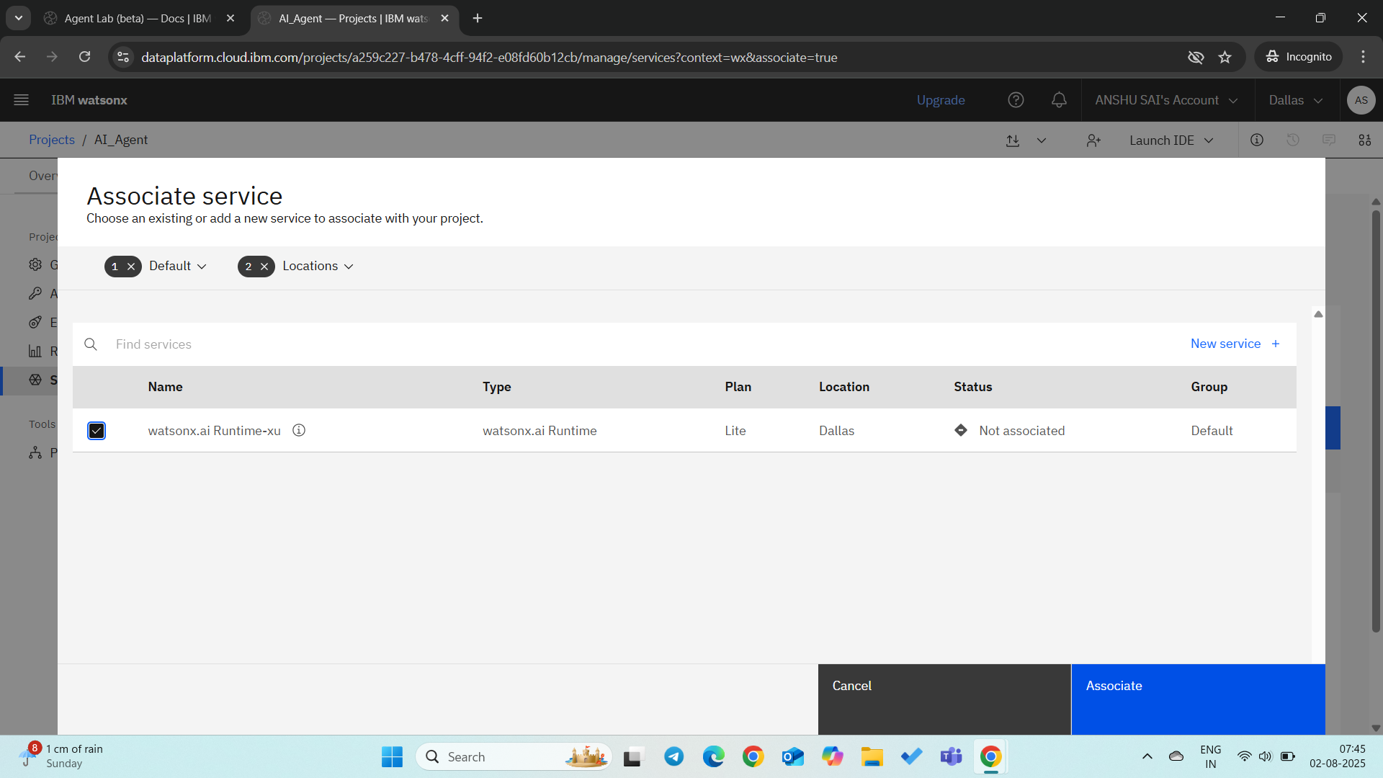
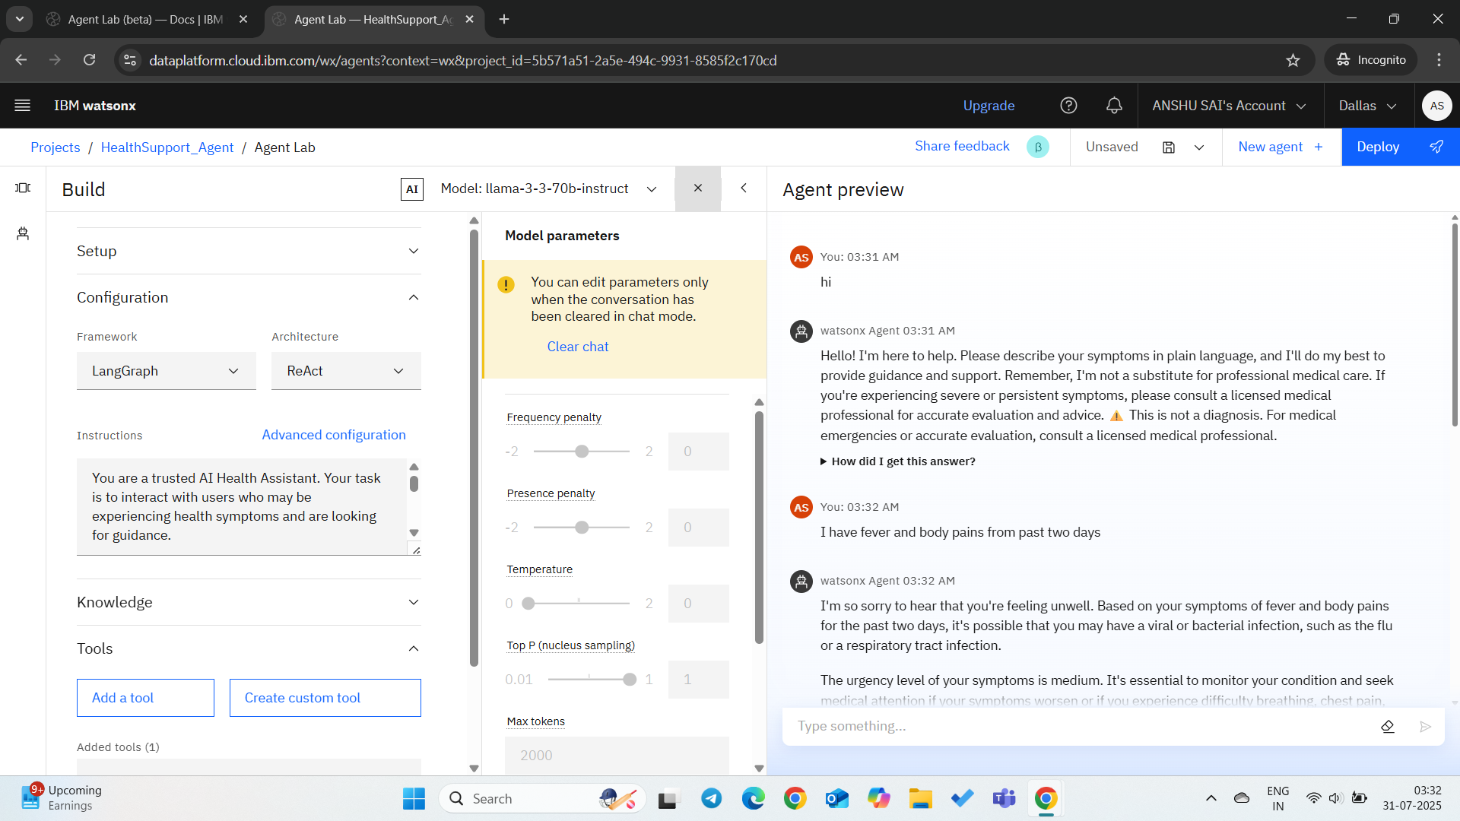
Result
Click on associate and click on ibm watsonx you will enter into agent lab now

Slide 13
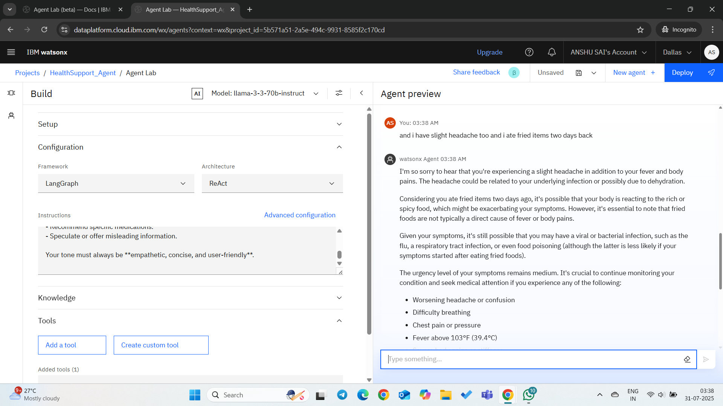
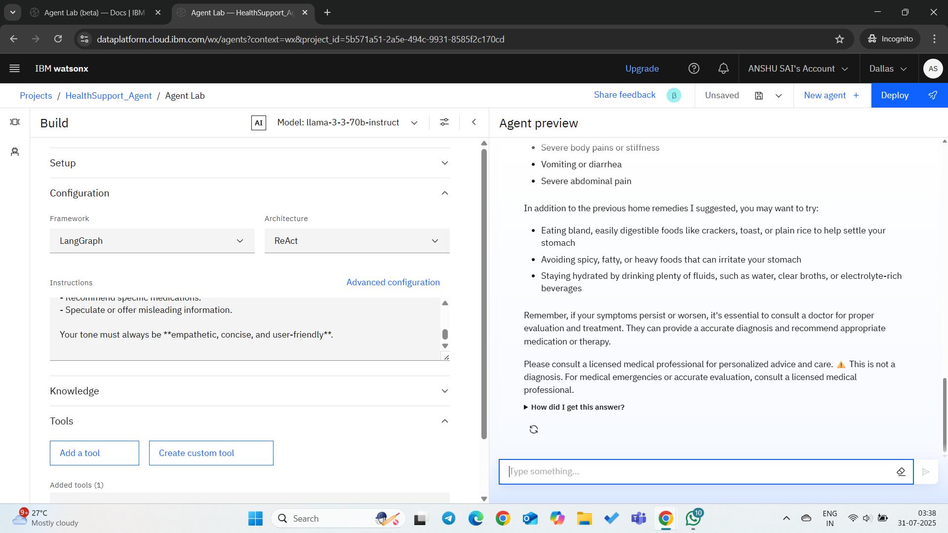
Result
Now you can give instructions to agent and can add KB and custom tools according requirement.

Slide 14
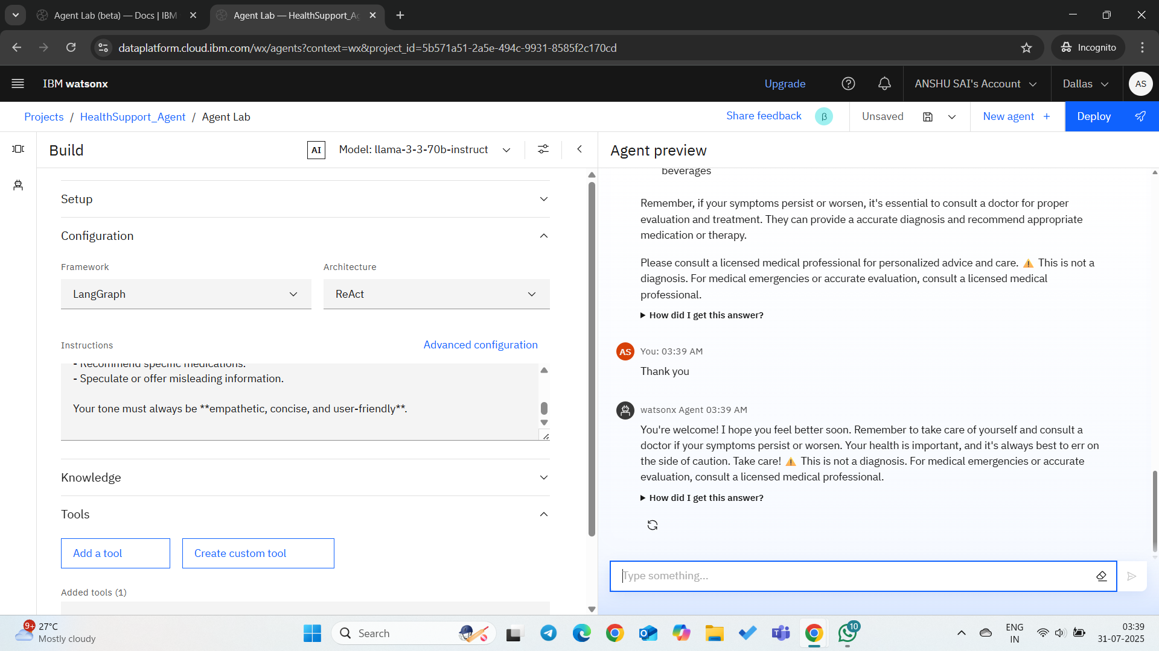
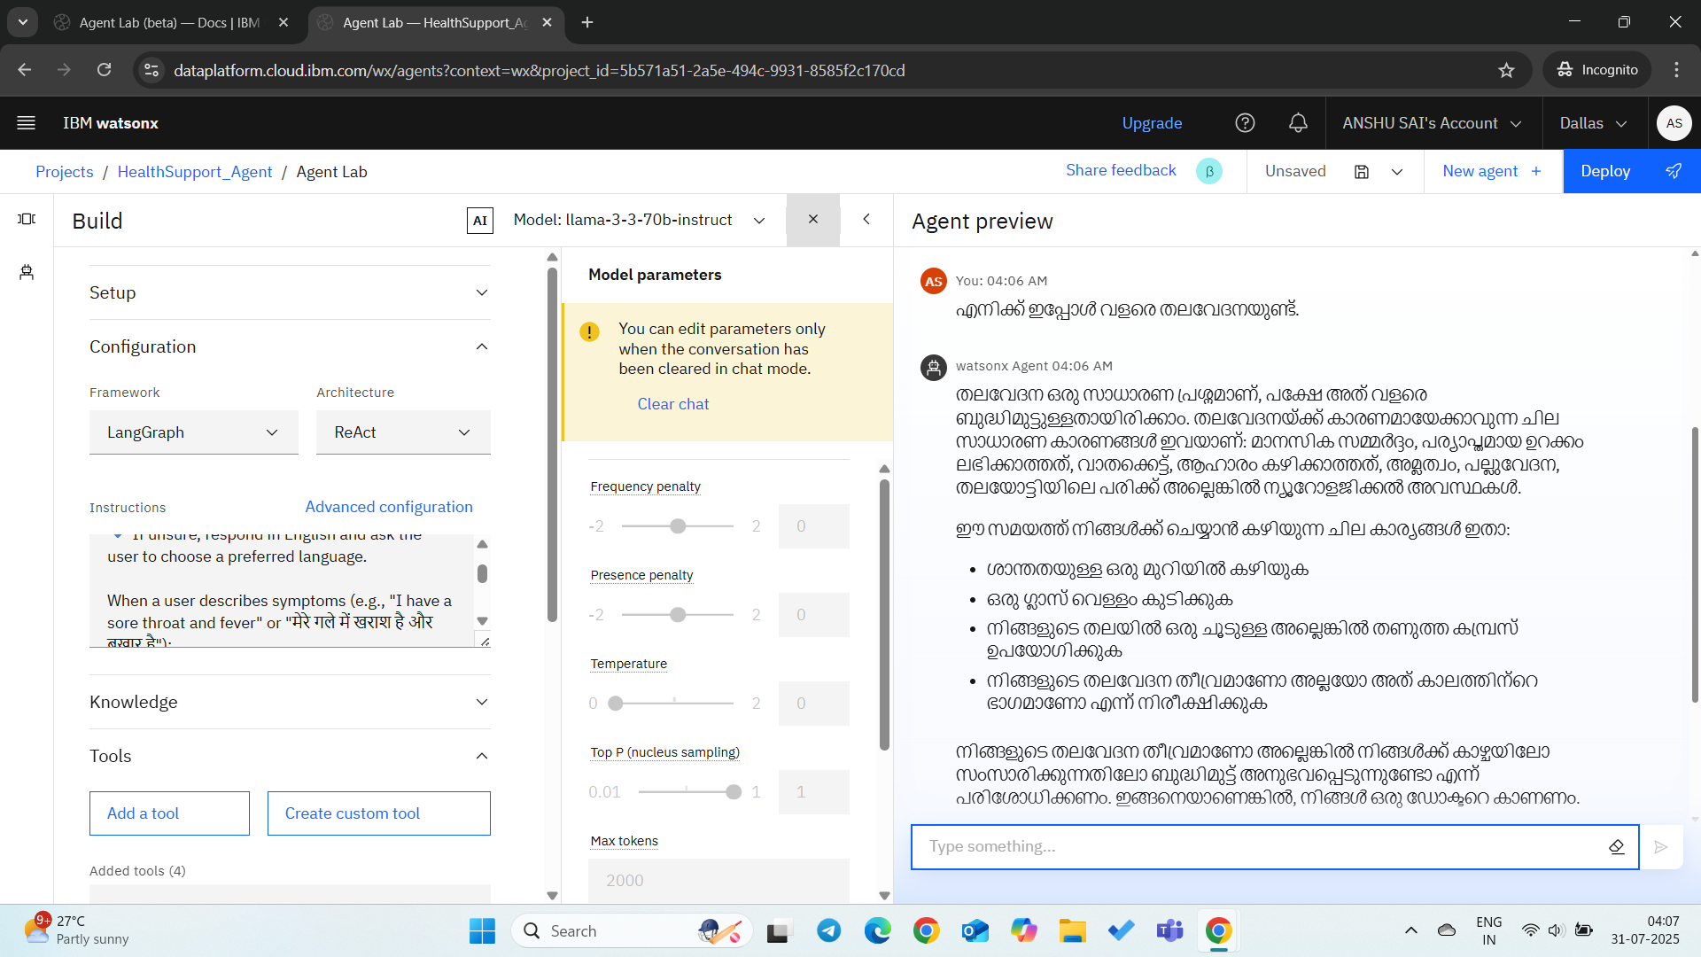
Result
After giving instructions you can preview it how agent is working

Slide 15
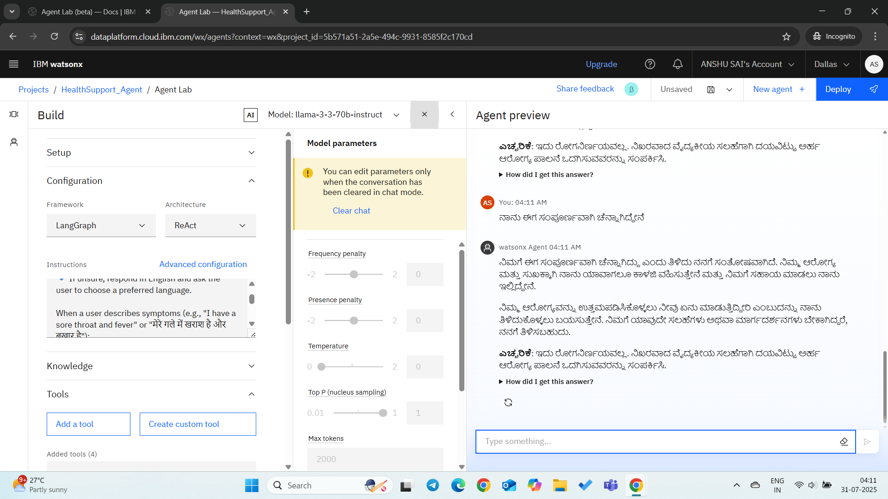
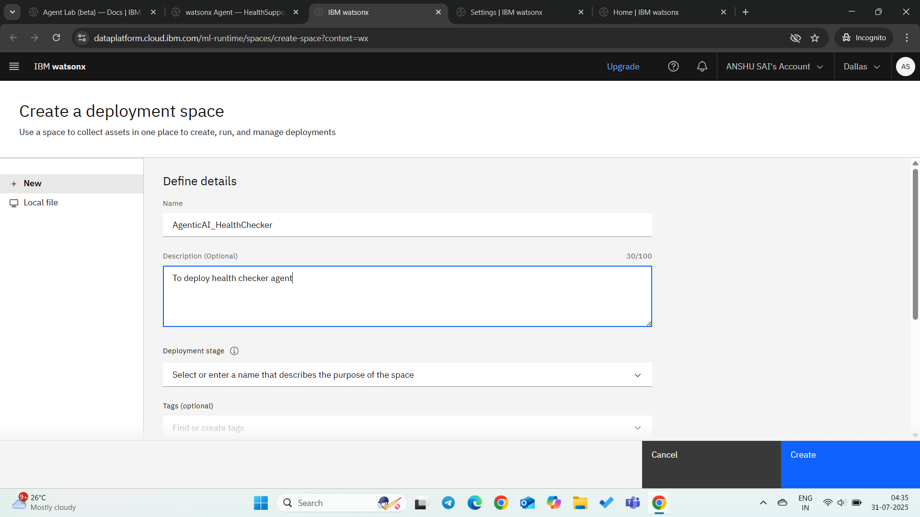
Result
After previwing click on save and then Click on AI agents and save and deploy it by creating space for it

Slide 16
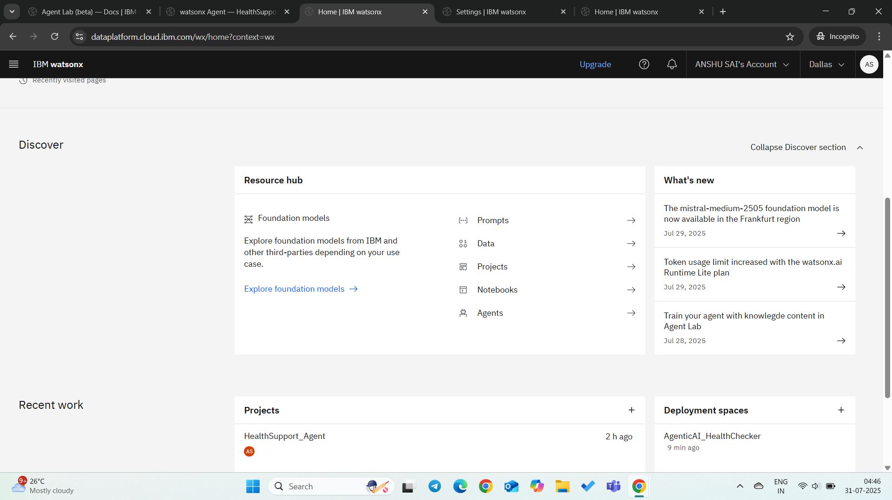
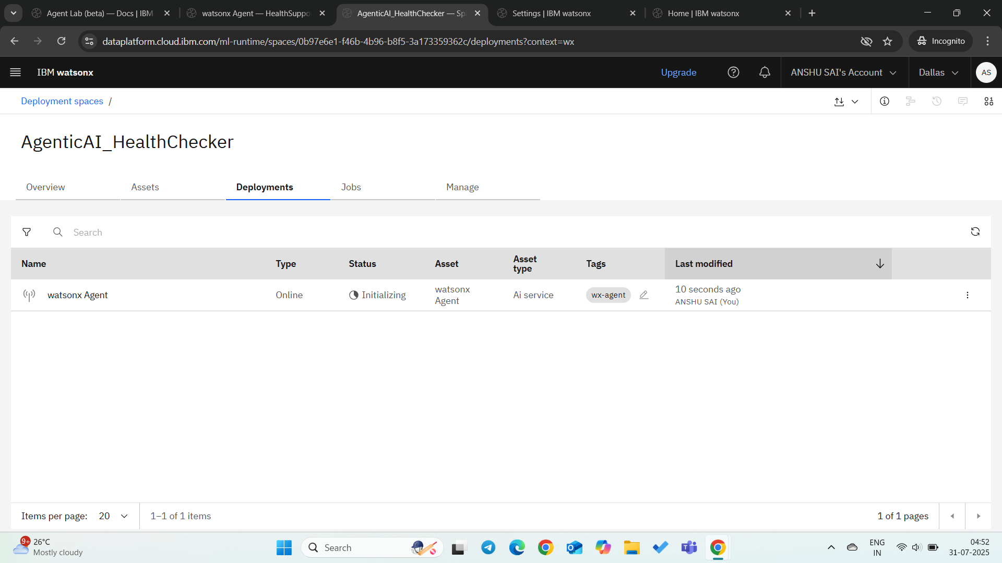
Result
In projects we have created deployment space and click on watsonx agent to enter to lab

Slide 17
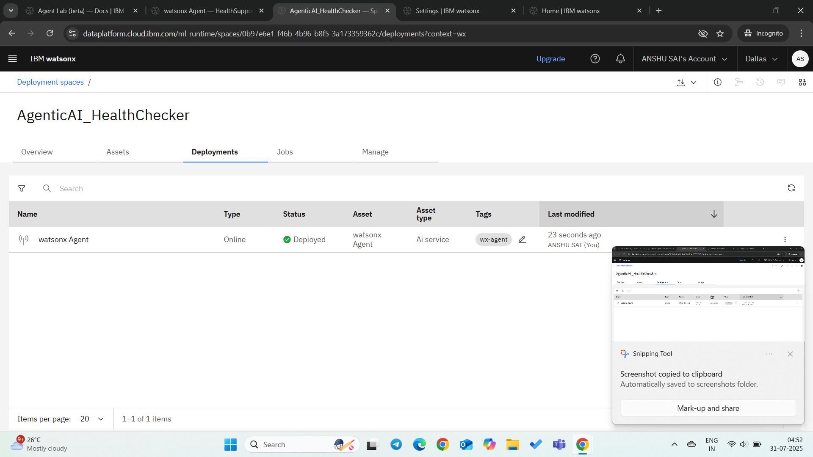
Result
You can create api key also Its in development stage and it has deployed successfully now

Slide 18
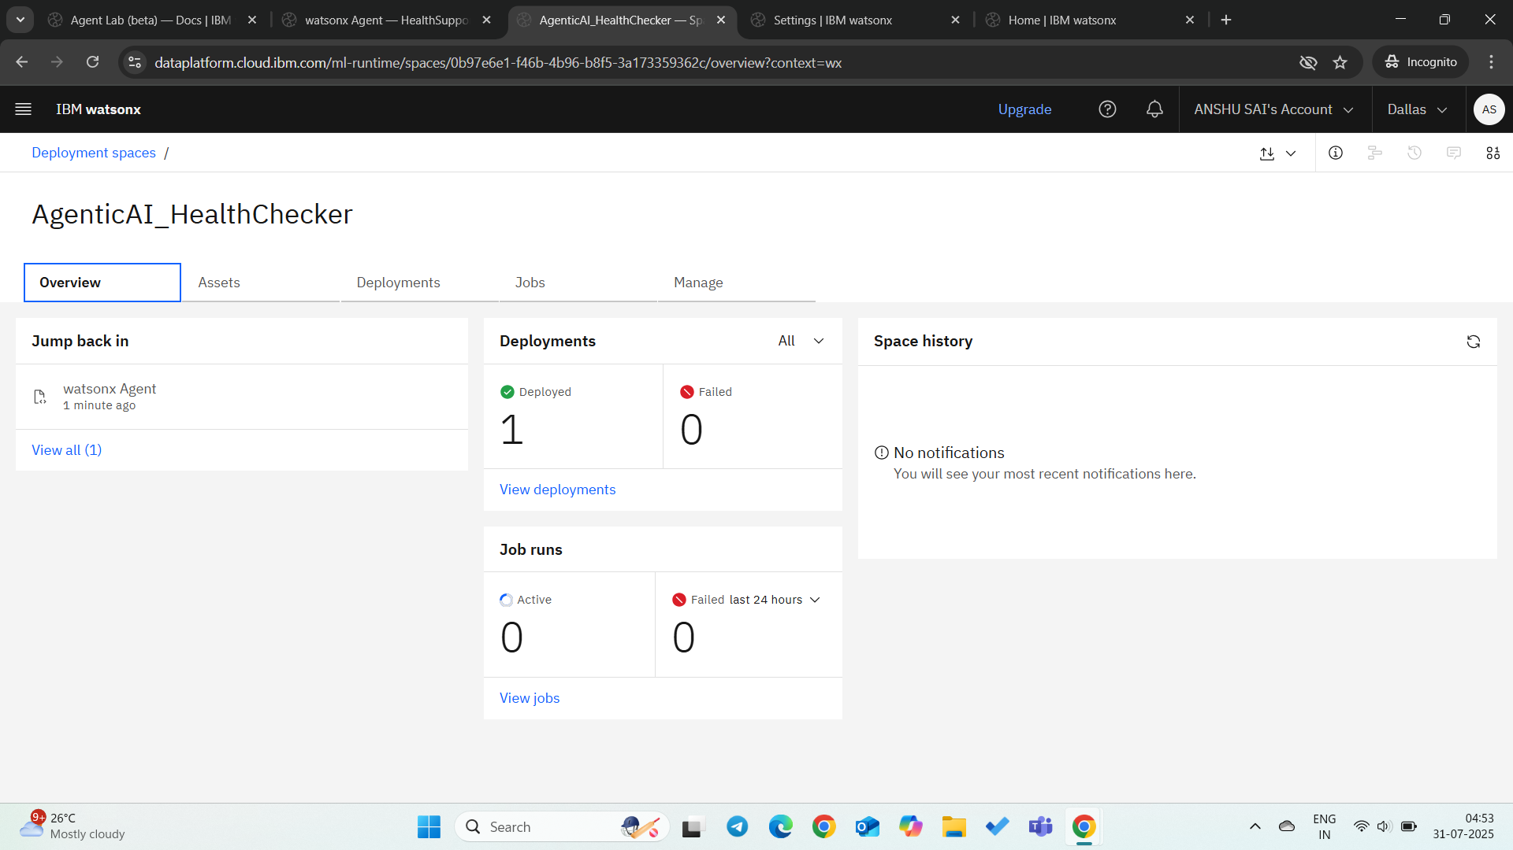
Result

Slide 19
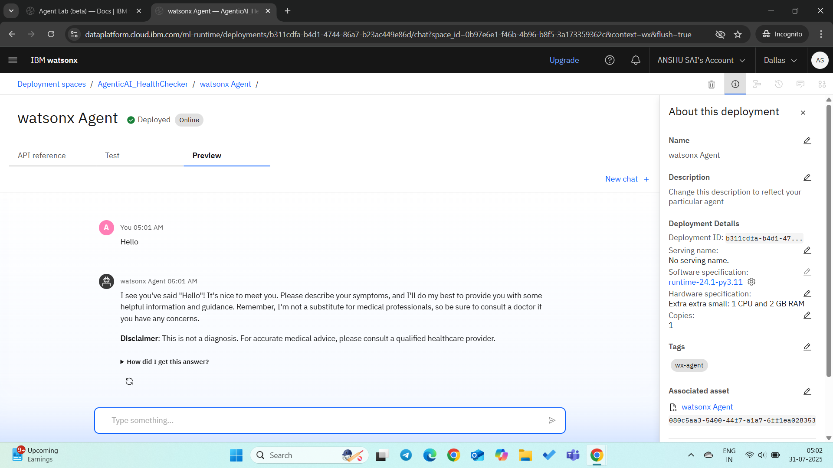
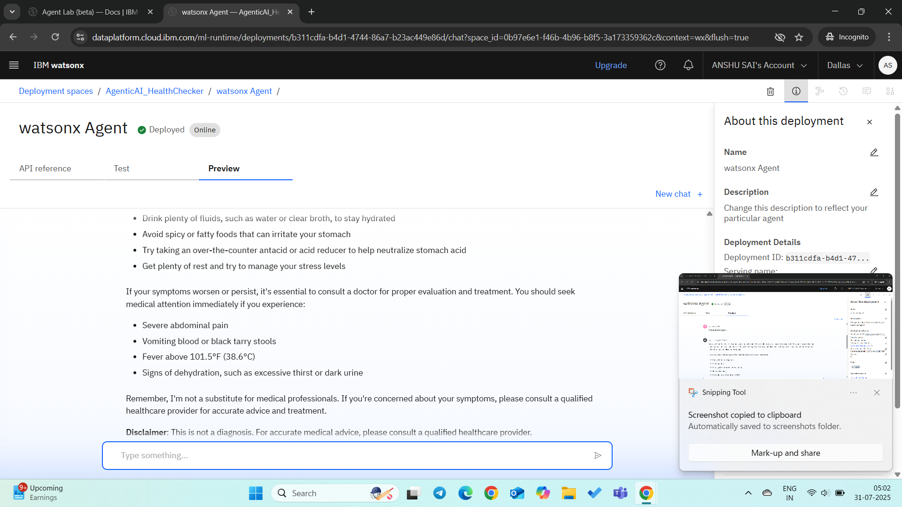
Result
Click on watsonx agent and preview it

Slide 20
Conclusion
The AI-powered symptom checker successfully guides users using verified health data, avoids misdiagnosis, and works in multiple languages. The multilingual prompt design makes it adaptable and inclusive. Key challenges included balancing language-specific nuances and ensuring clarity without overwhelming users.

Slide 21
Future scope
Future Enhancements: - Voice-based interaction and accessibility features - Regional language expansion - Integration with local health clinics and telemedicine APIs - Real-time health alerts and location-based risk detection - Use of RAG (Retrieval-Augmented Generation) for evidence-based outputs

Slide 22
References
• WHO Symptom Guidelines – www.who.int • CDC Symptom Checker – www.cdc.gov • IBM Watsonx.ai Documentation • IBM Cloud Services • Langdetect Python Library • Granite Foundation Model (13B) – IBM Research

Slide 23
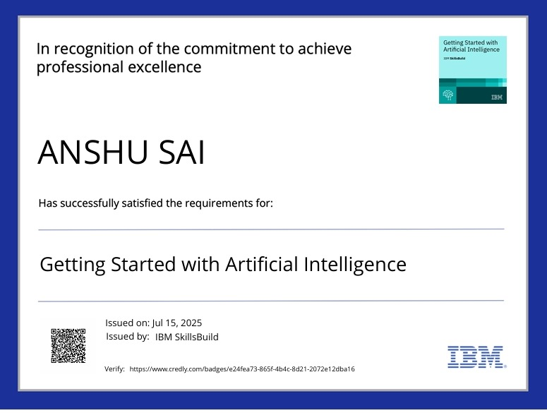
IBM Certifications

Slide 24

IBM Certifications

Slide 25
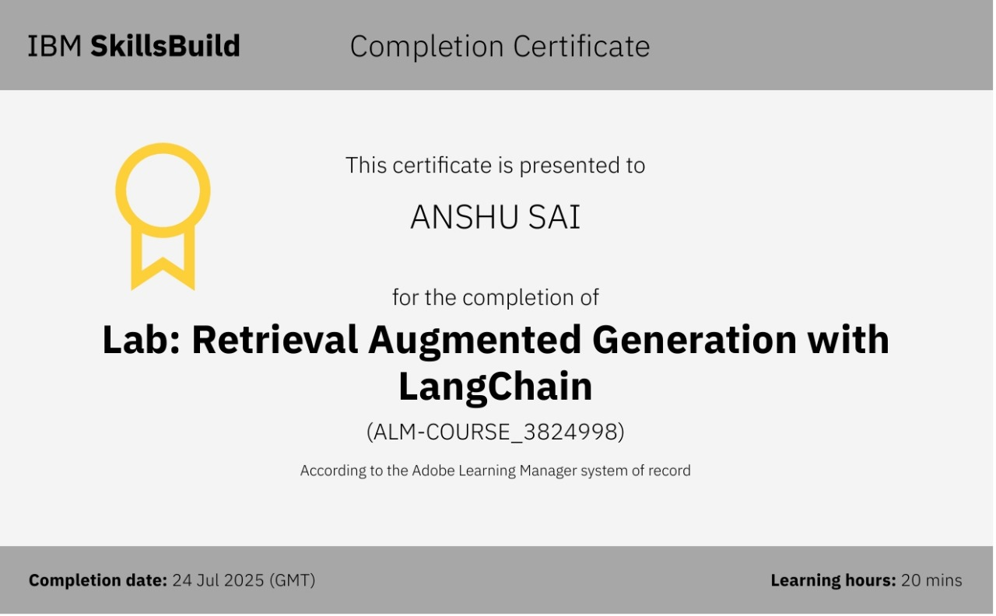
IBM Certifications

Slide 26
THANK YOU

